Slide 1
Pensieve
Reflection made simple

Slide 2
Problems
1. Users are unable to cement memories in a consistent and frictionless manner
2. Existing solutions are unintuitive and result in unorganized collections of random experiences
Notes:
Problem:
People want to cement their memories but are unable to do so in a consistent and frictionless manner. Existing solutions are unintuitive and result in unorganized collections of random experiences.

Slide 3
Solution
A tabula rasa that allows users to record, edit, and organize their memories

Slide 4
Simple Task
Creating mementos at the time of/day of

Slide 5
Moderate Task
Reflecting about specific memories

Slide 6
Complex Task
Mapping mementos by creating relational associations

Slide 7
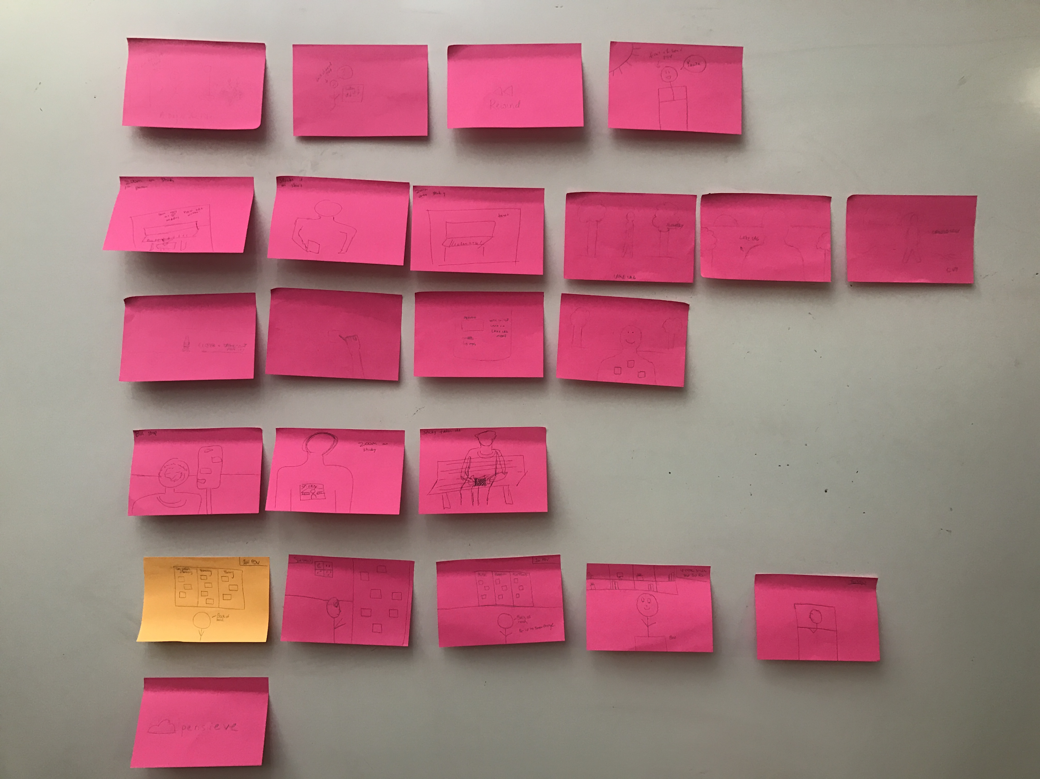
Storyboard
Notes:
Problem:
People want to cement their memories but are unable to do so in a consistent and frictionless manner. Existing solutions are unintuitive and result in unorganized collections of random experiences.

Slide 8
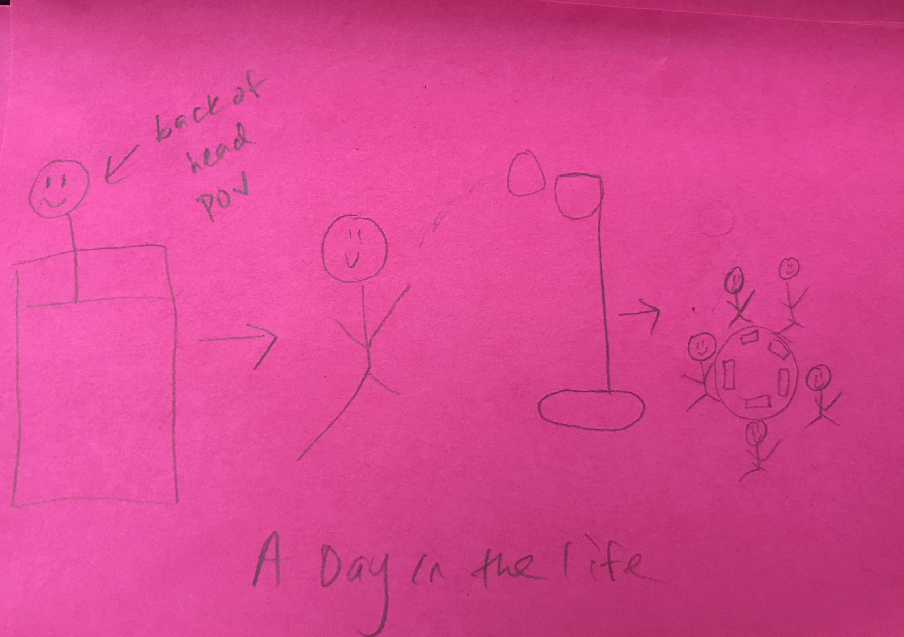
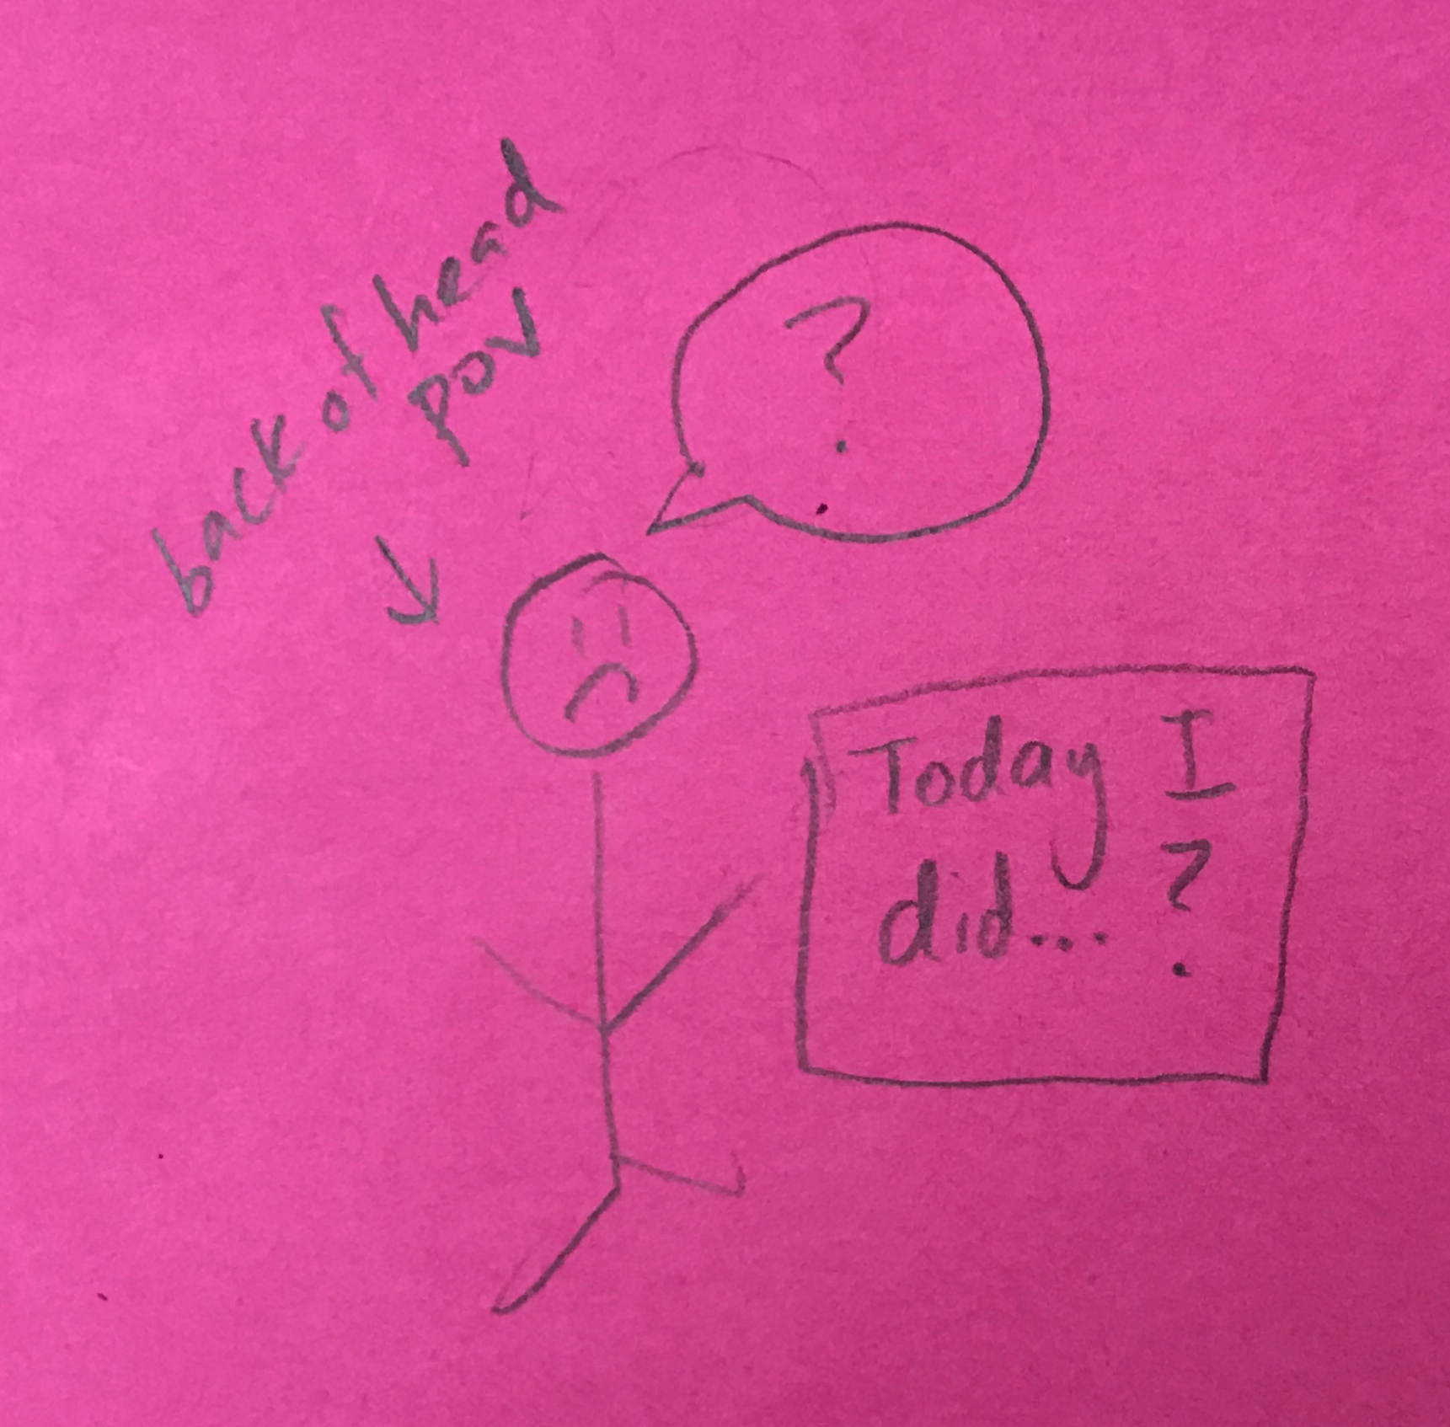
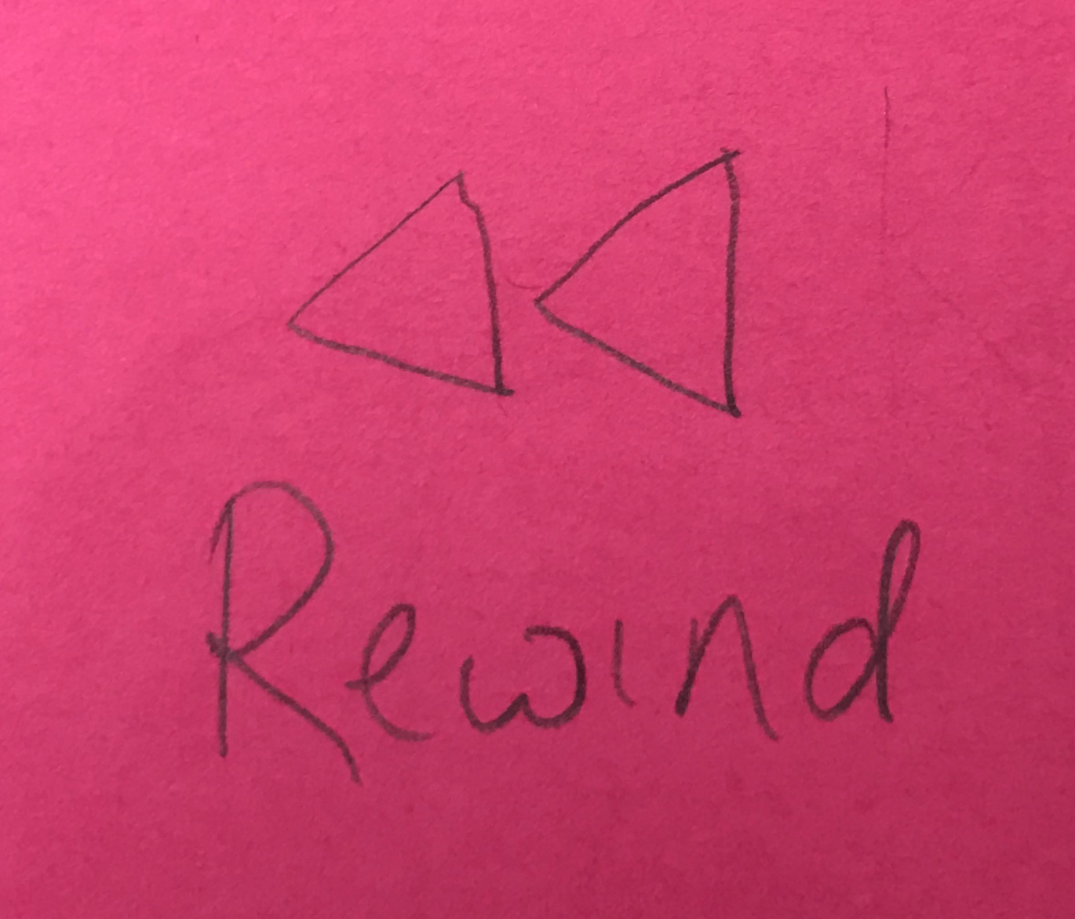
Addressing the Problem
Notes:
Problem:
People want to cement their memories but are unable to do so in a consistent and frictionless manner. Existing solutions are unintuitive and result in unorganized collections of random experiences.

Slide 9
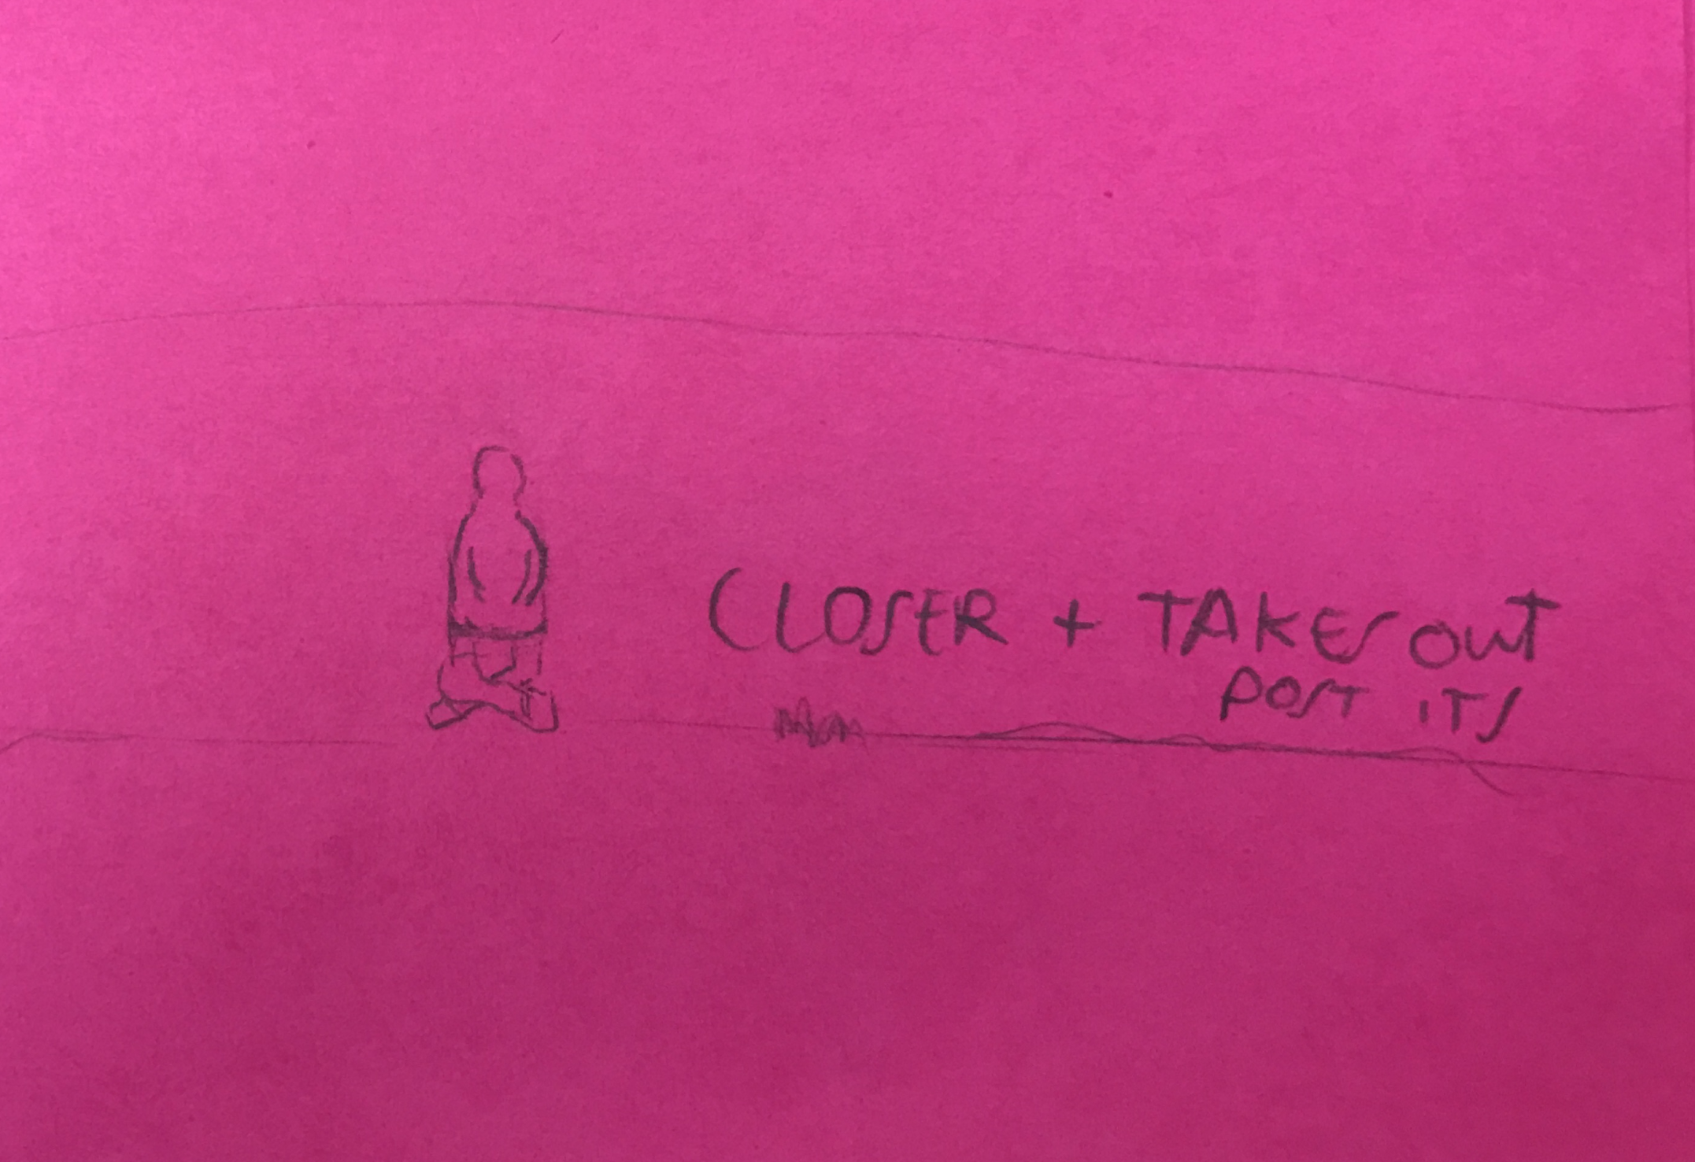
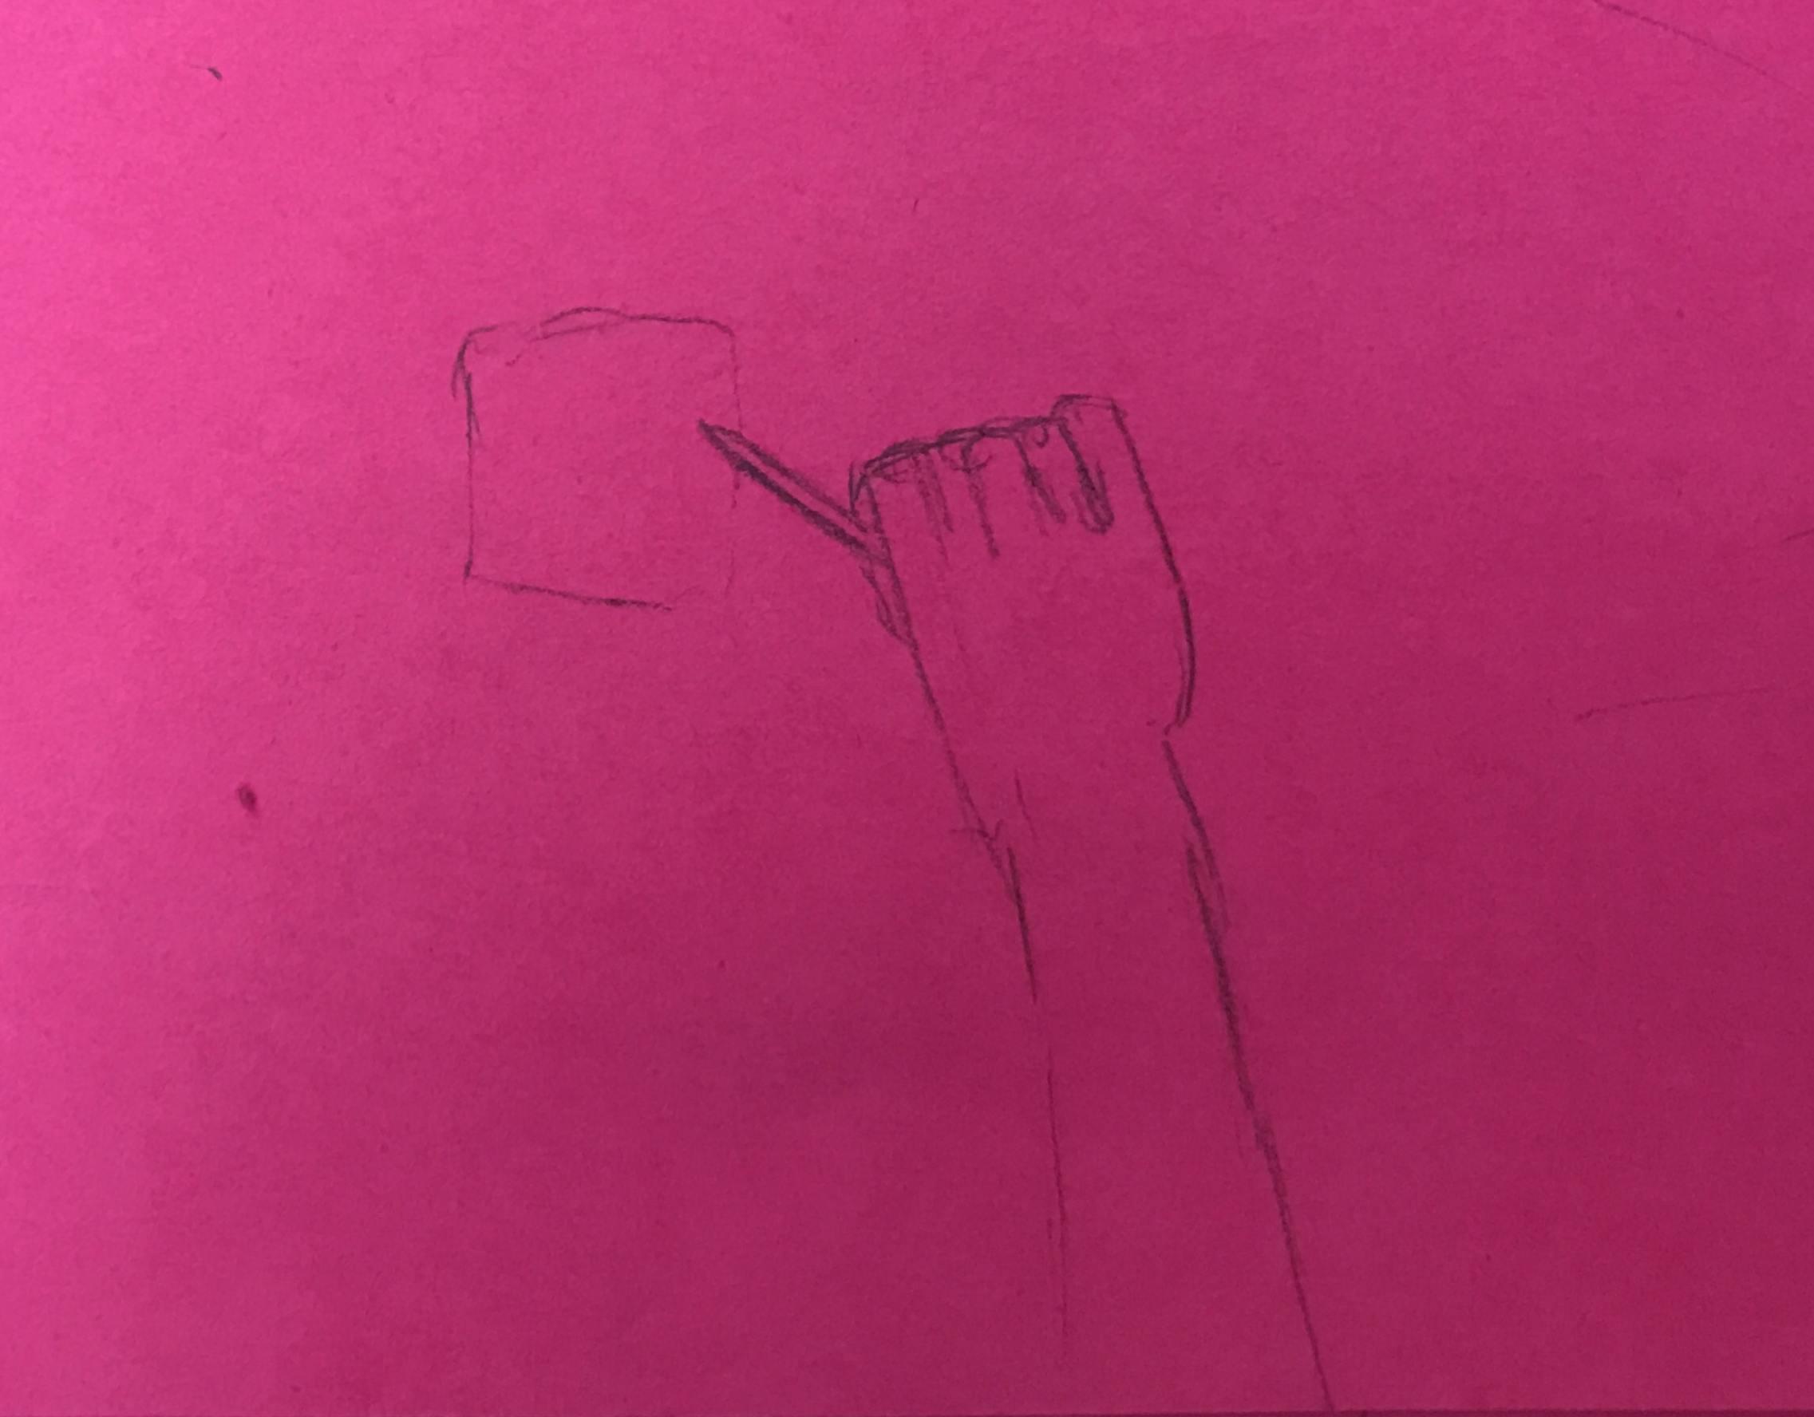
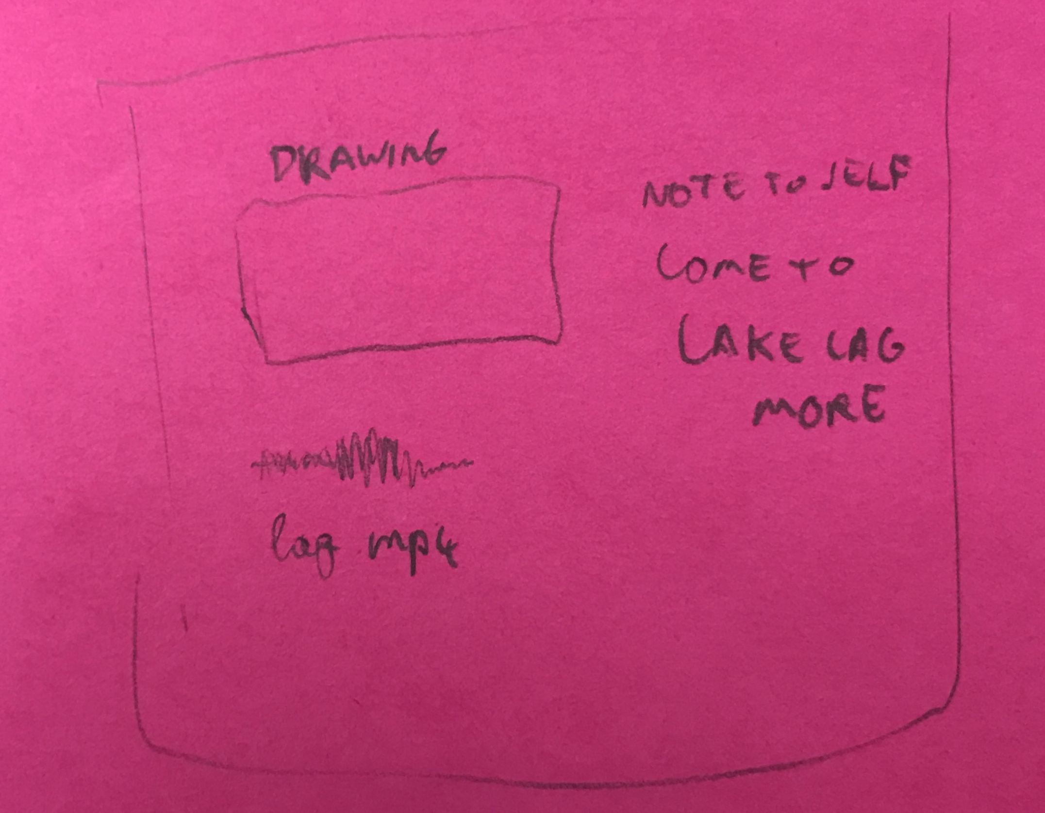
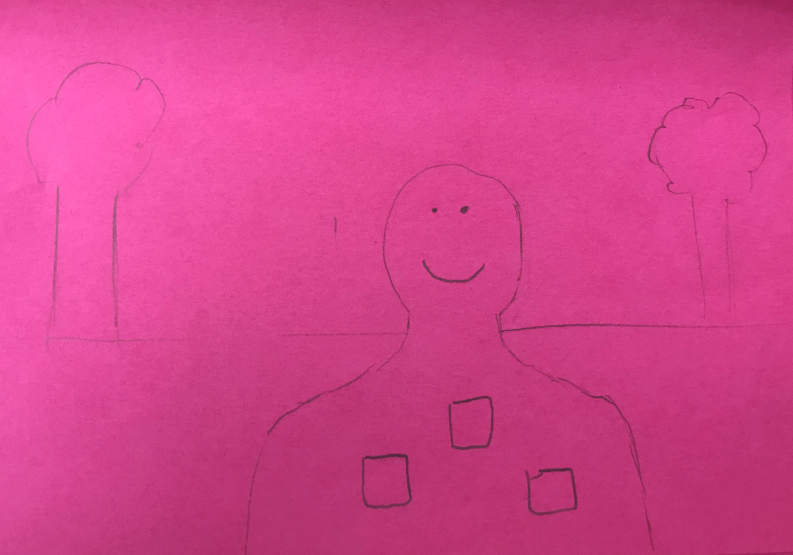
Simple Task

Slide 10
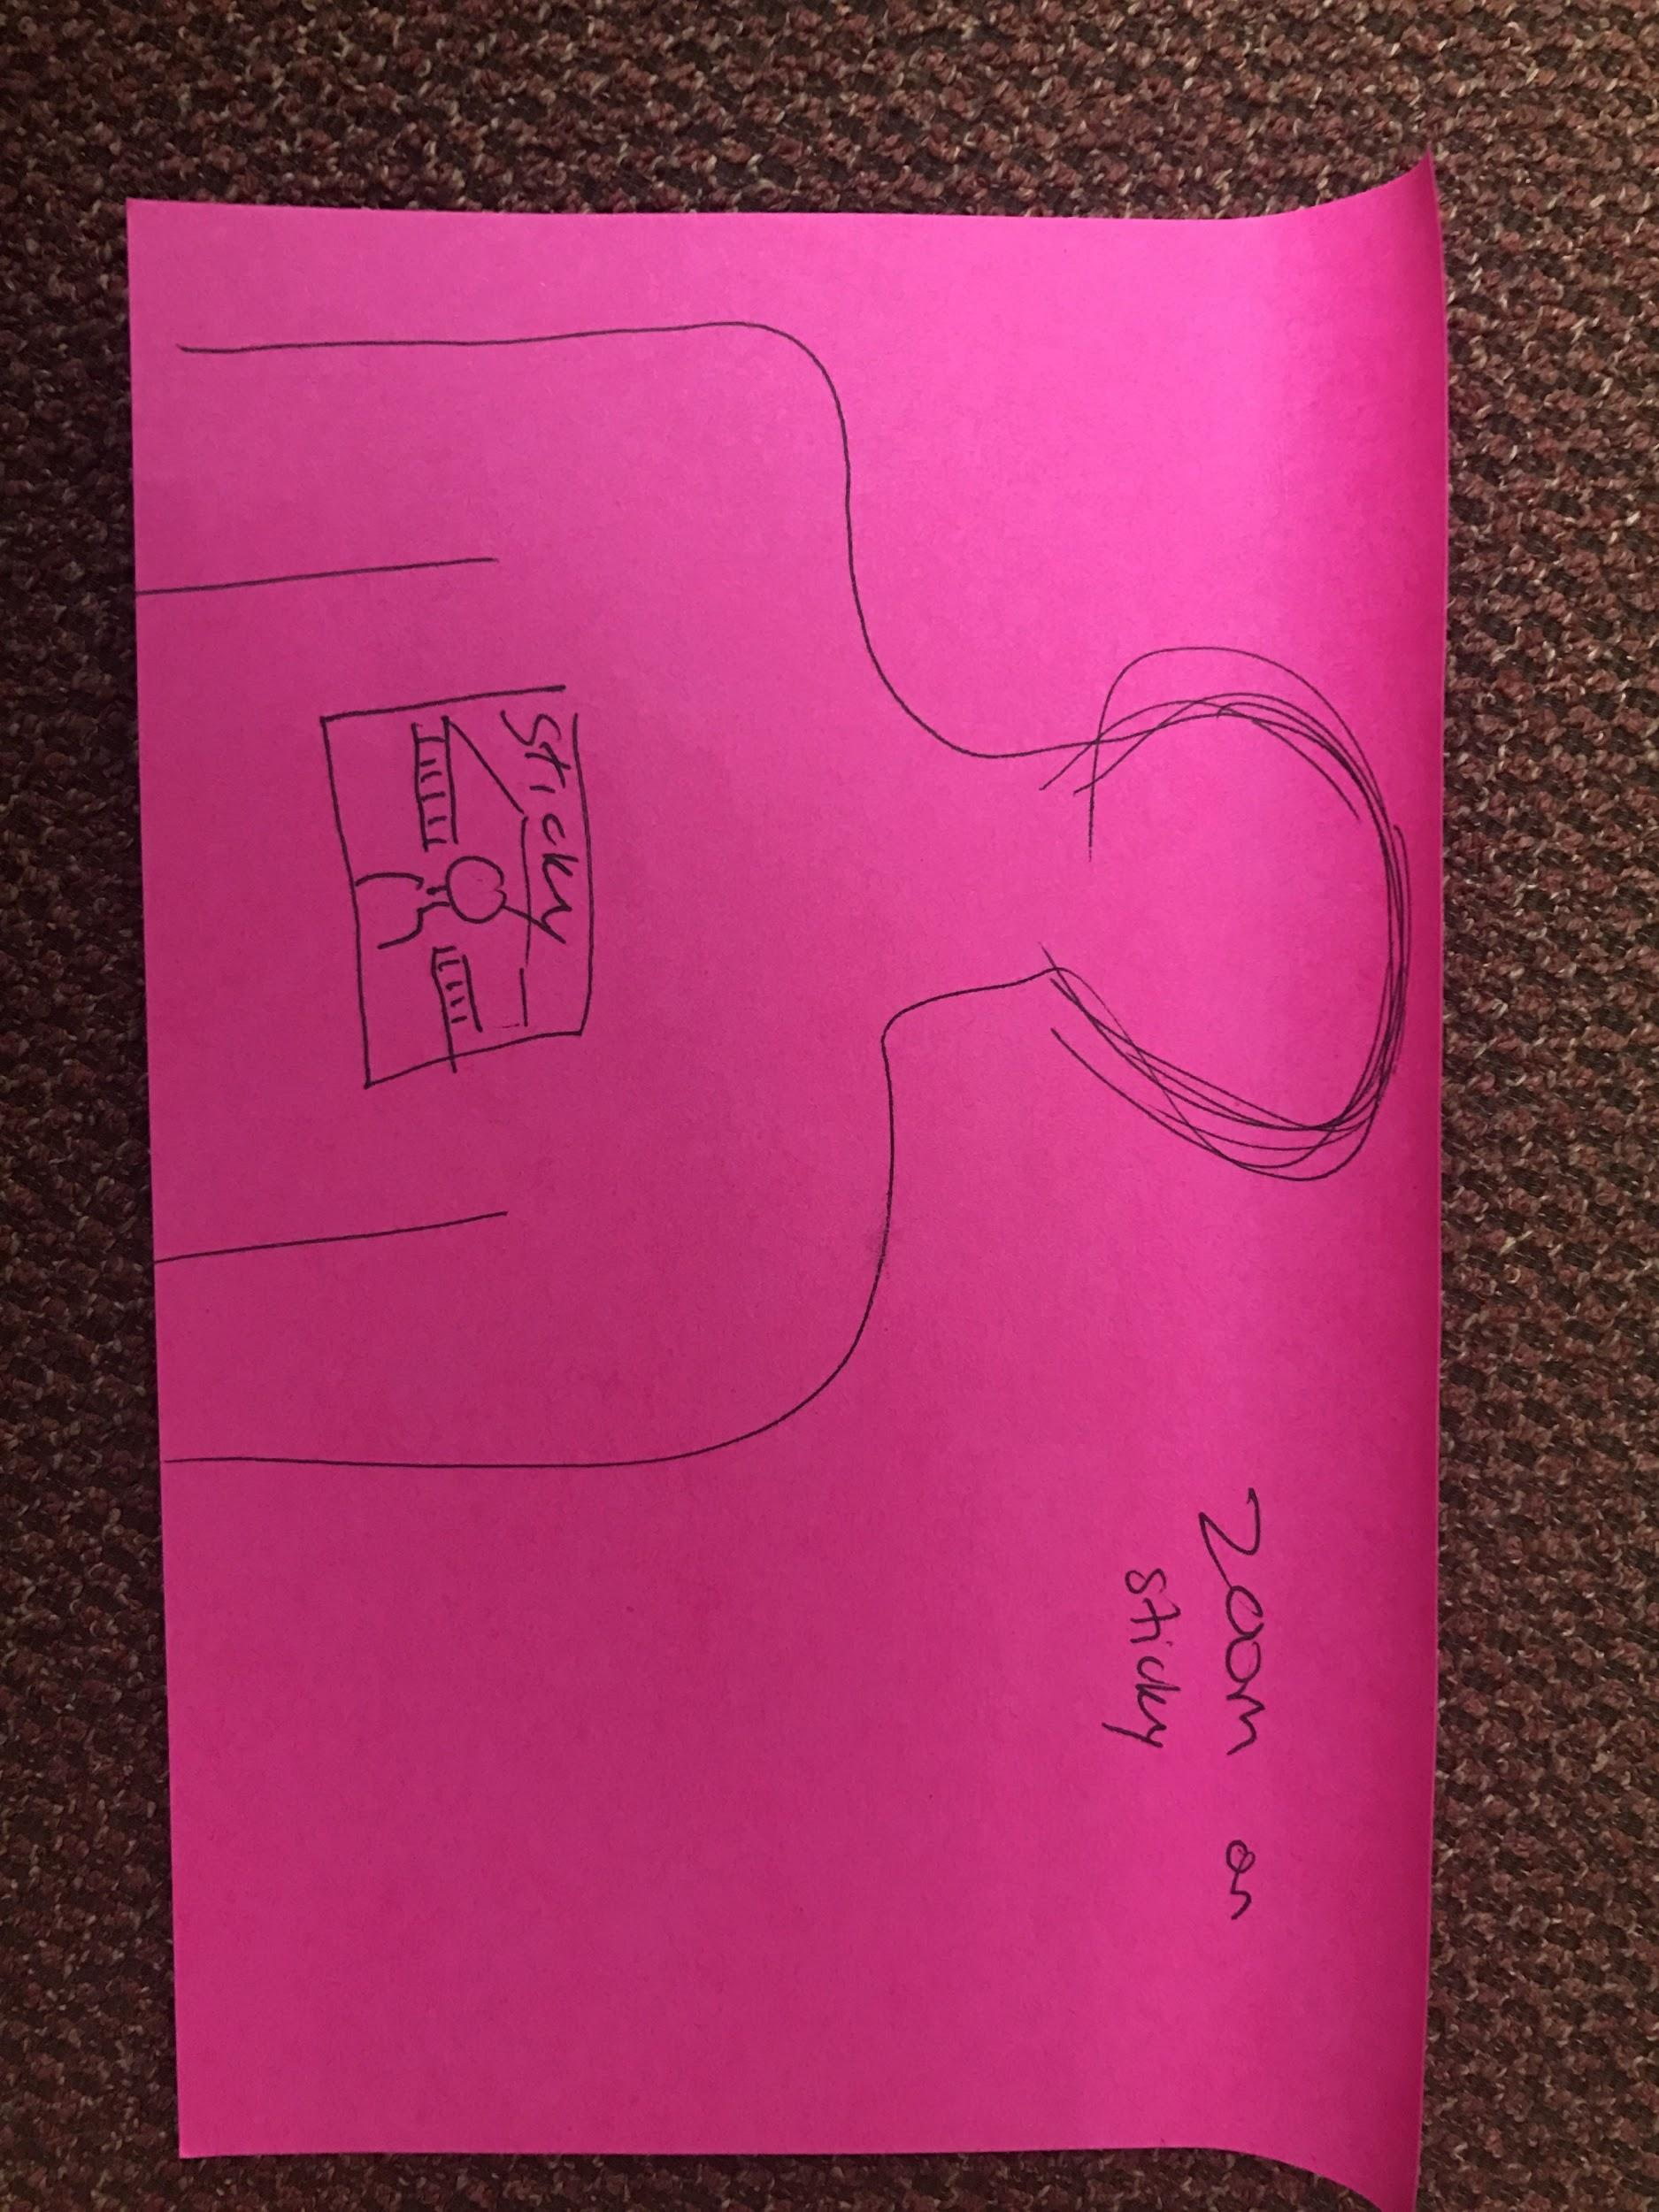
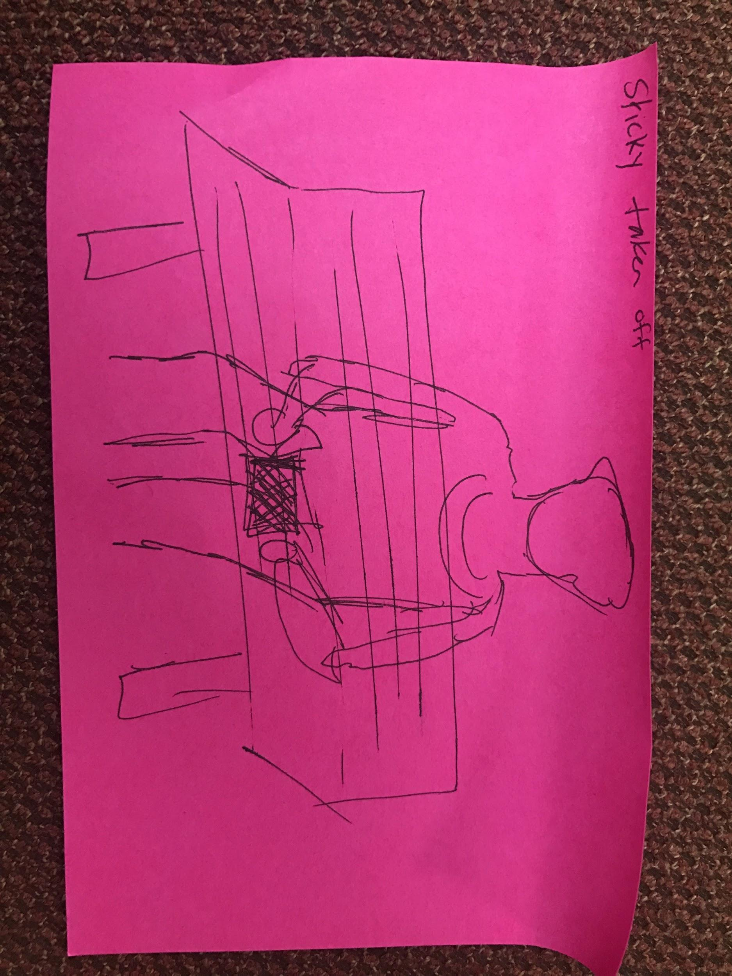
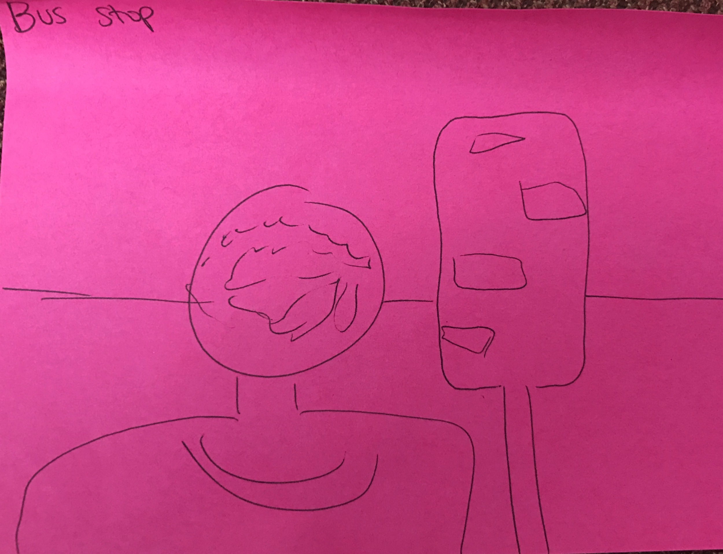
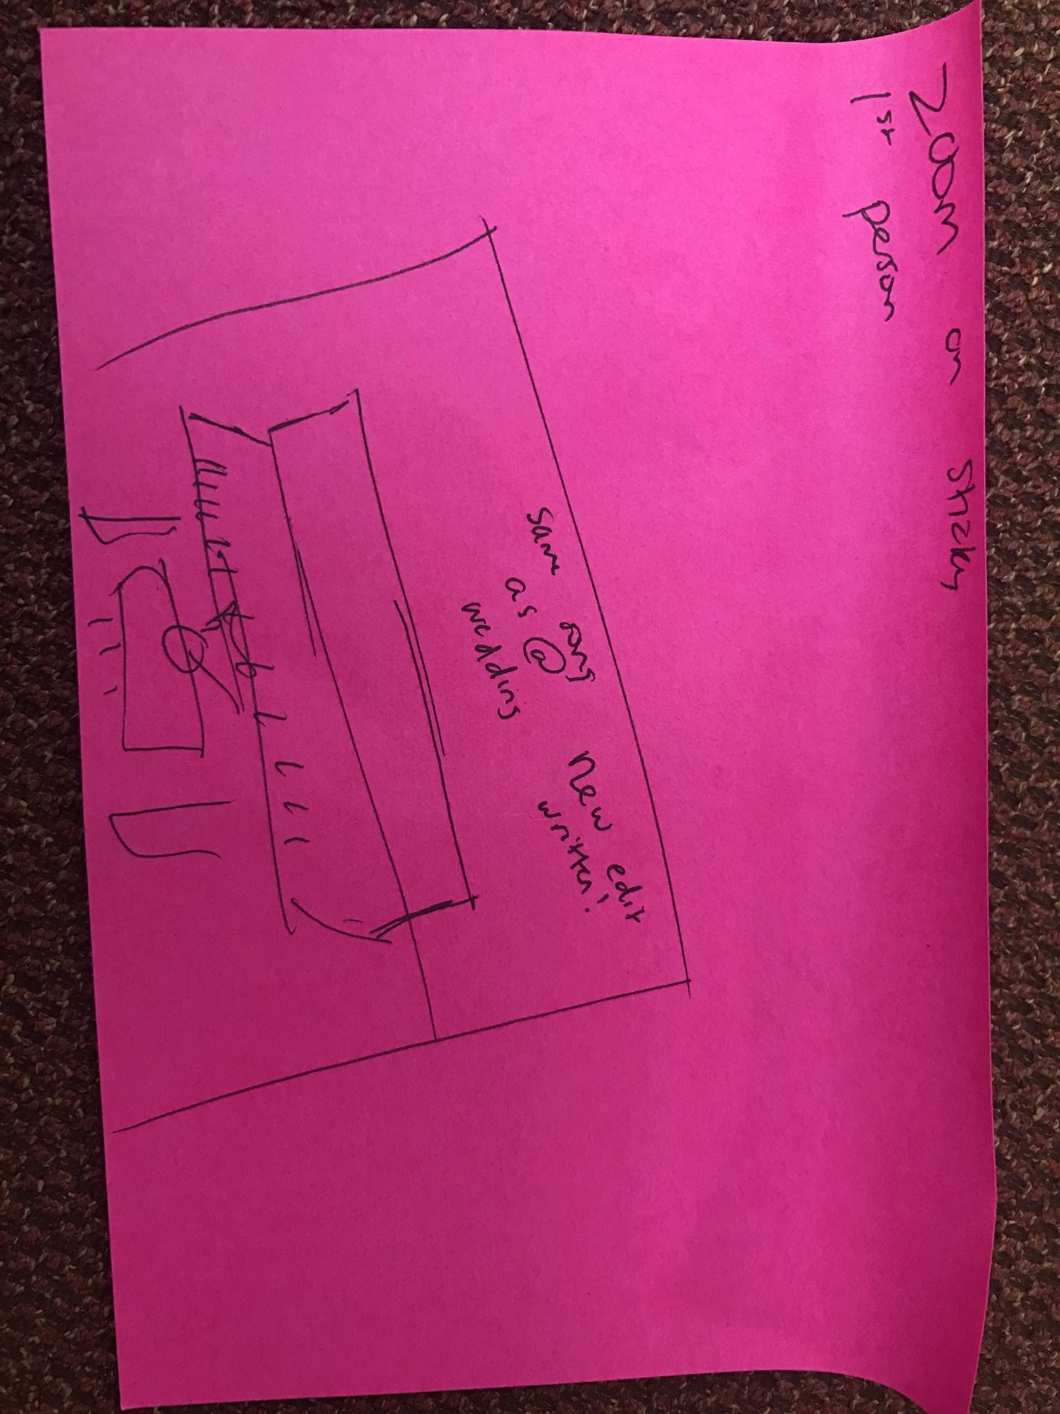
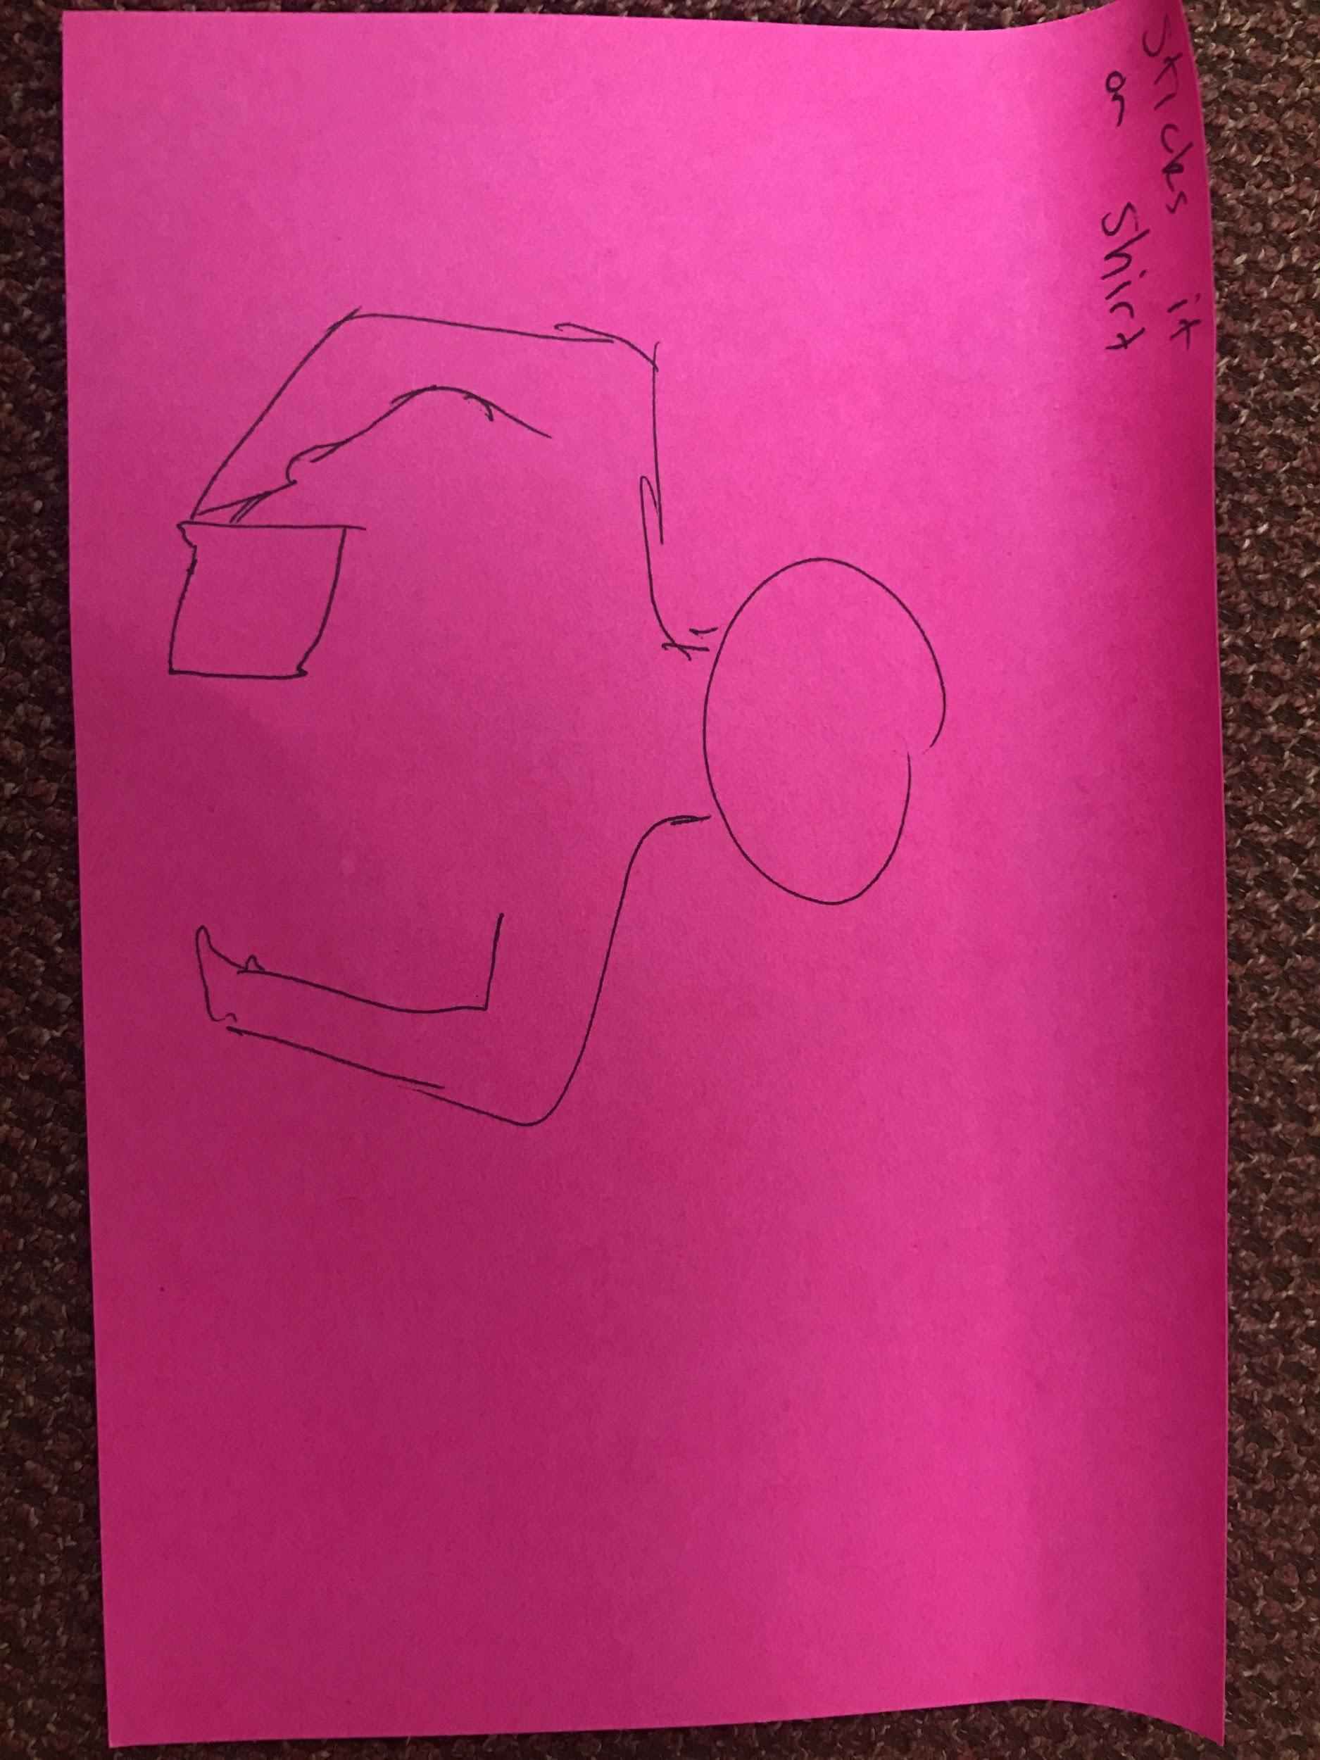
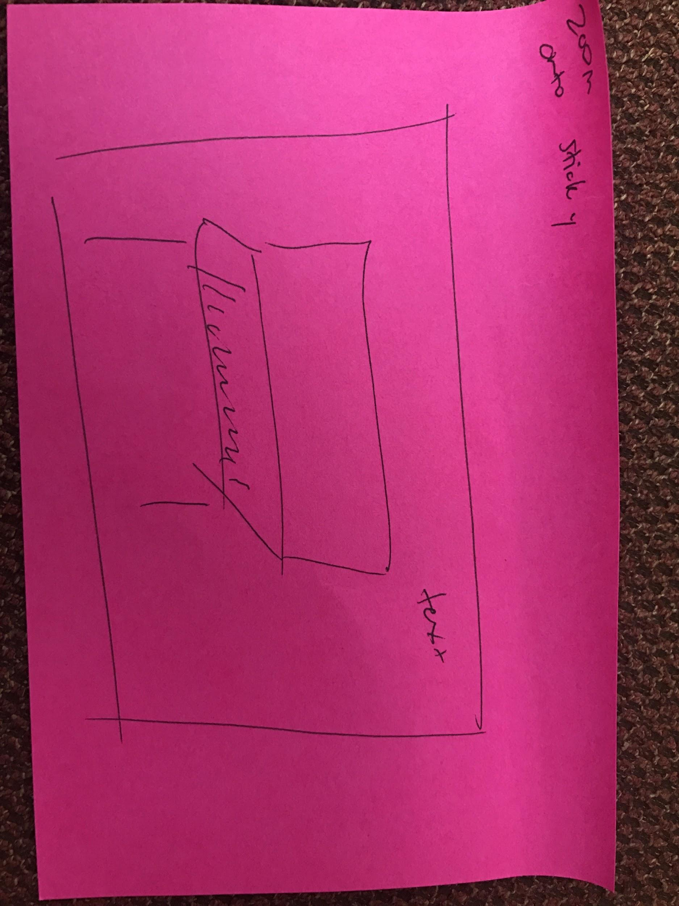
Moderate Task

Slide 11
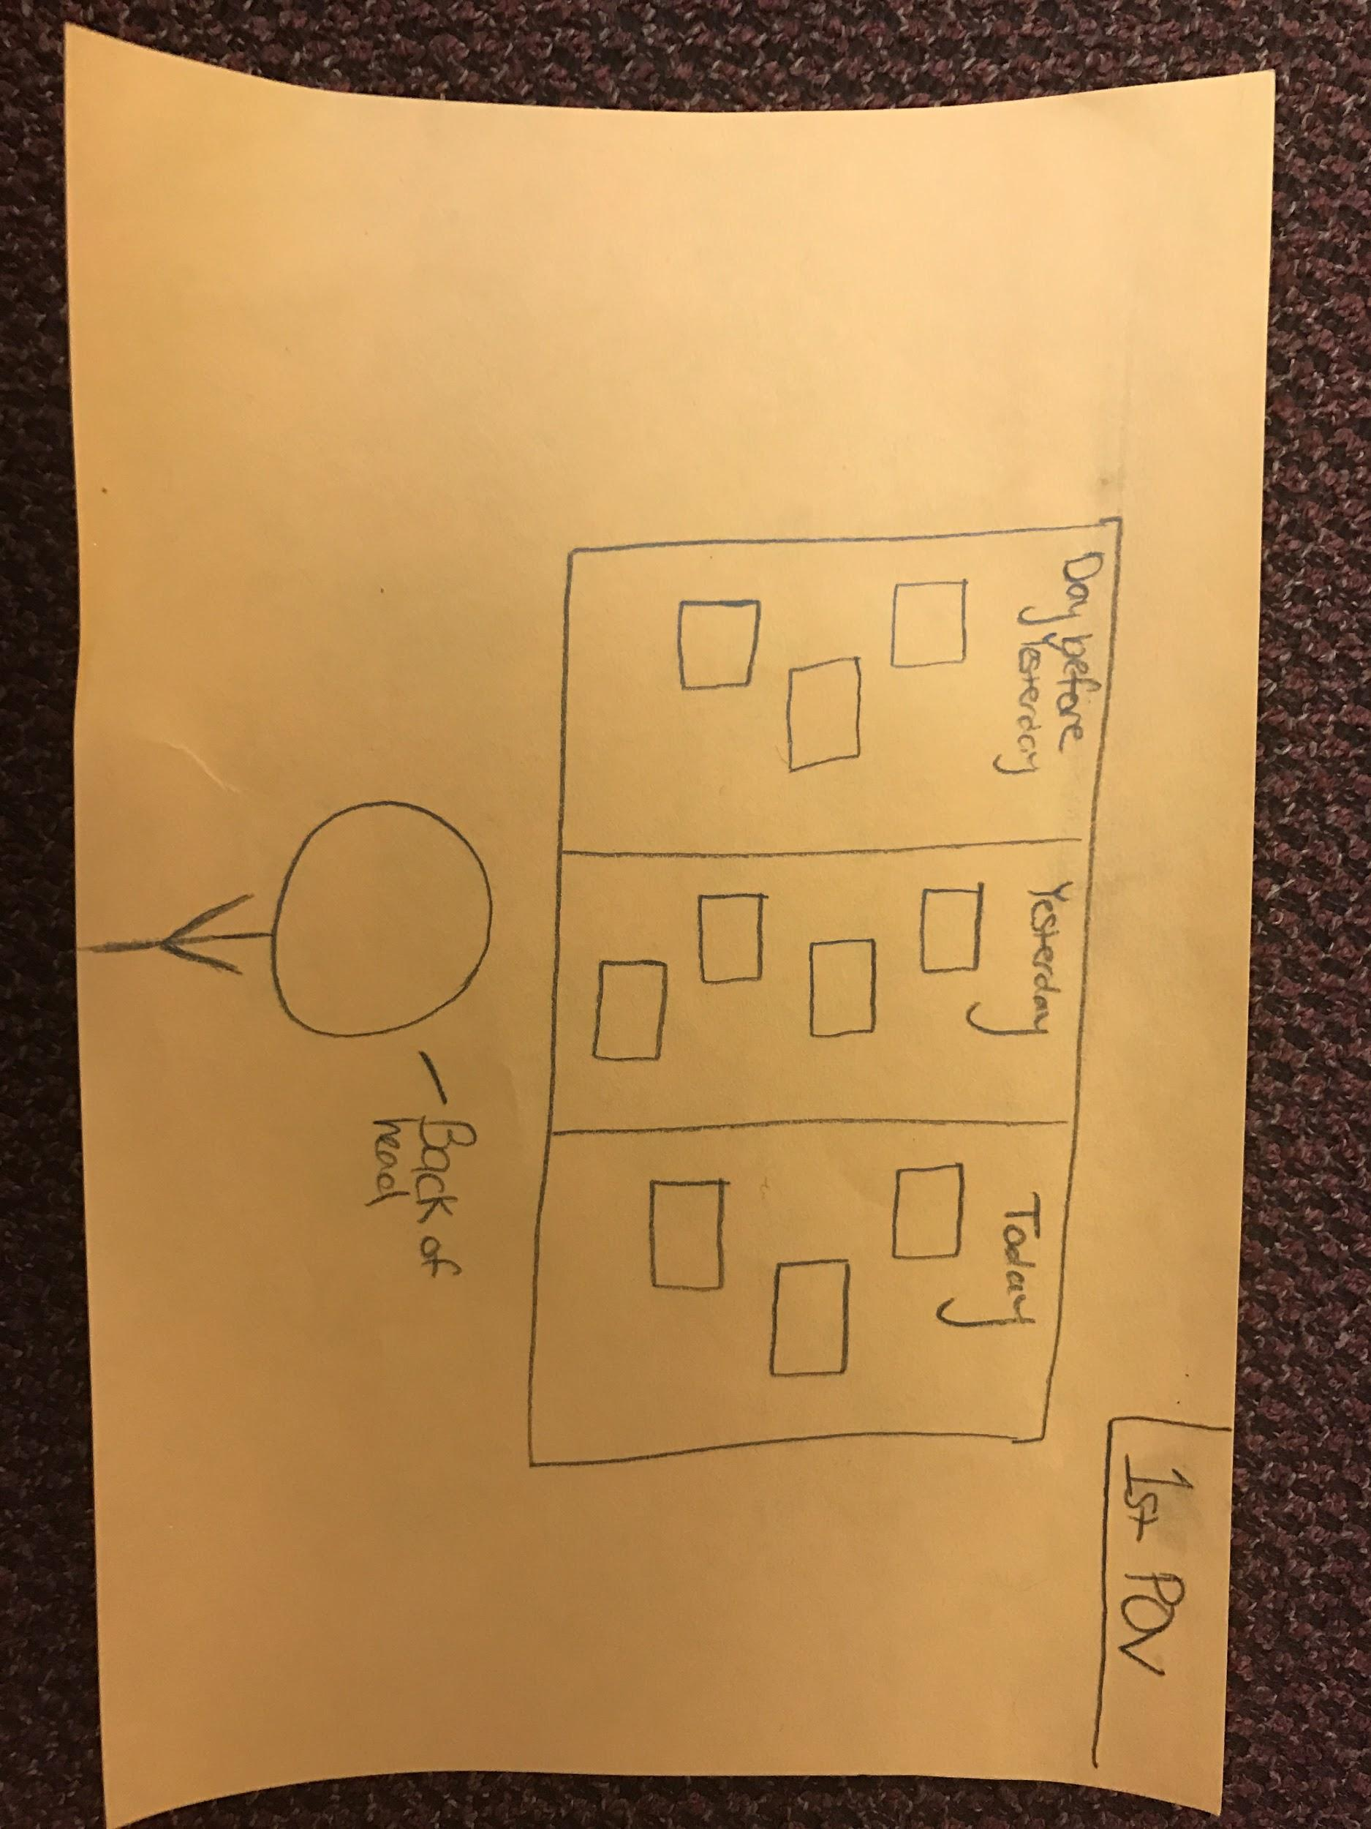
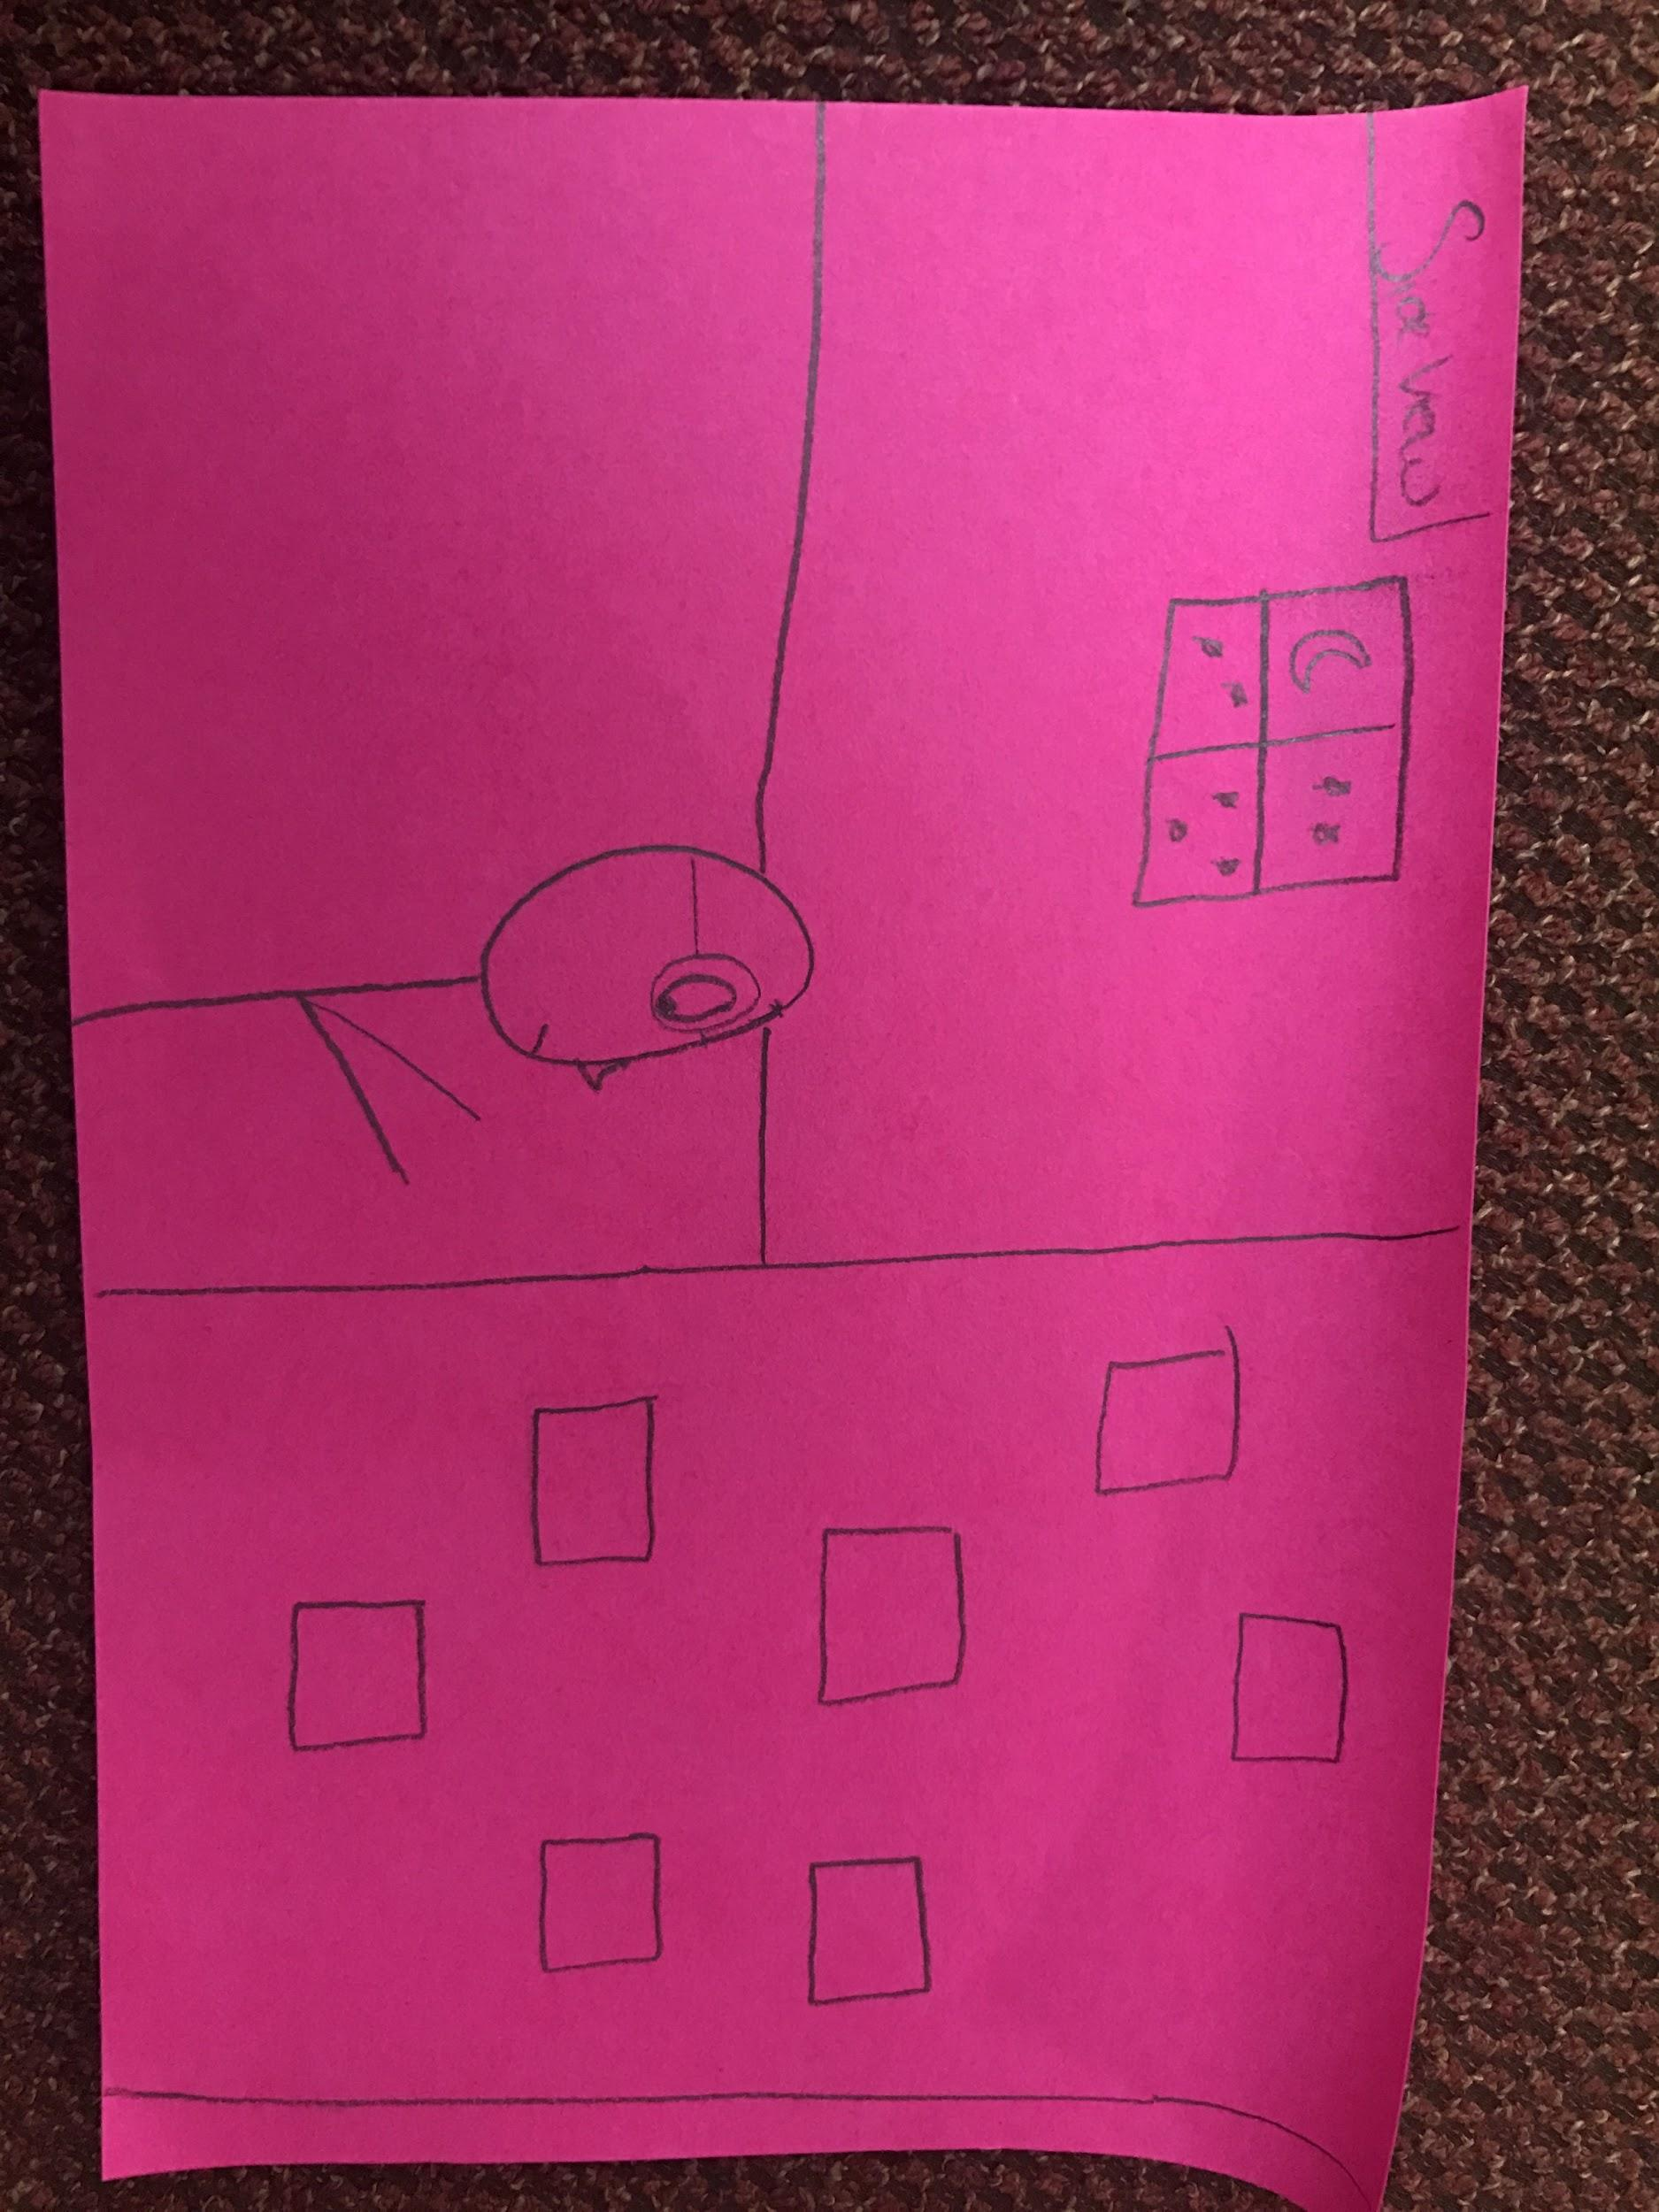
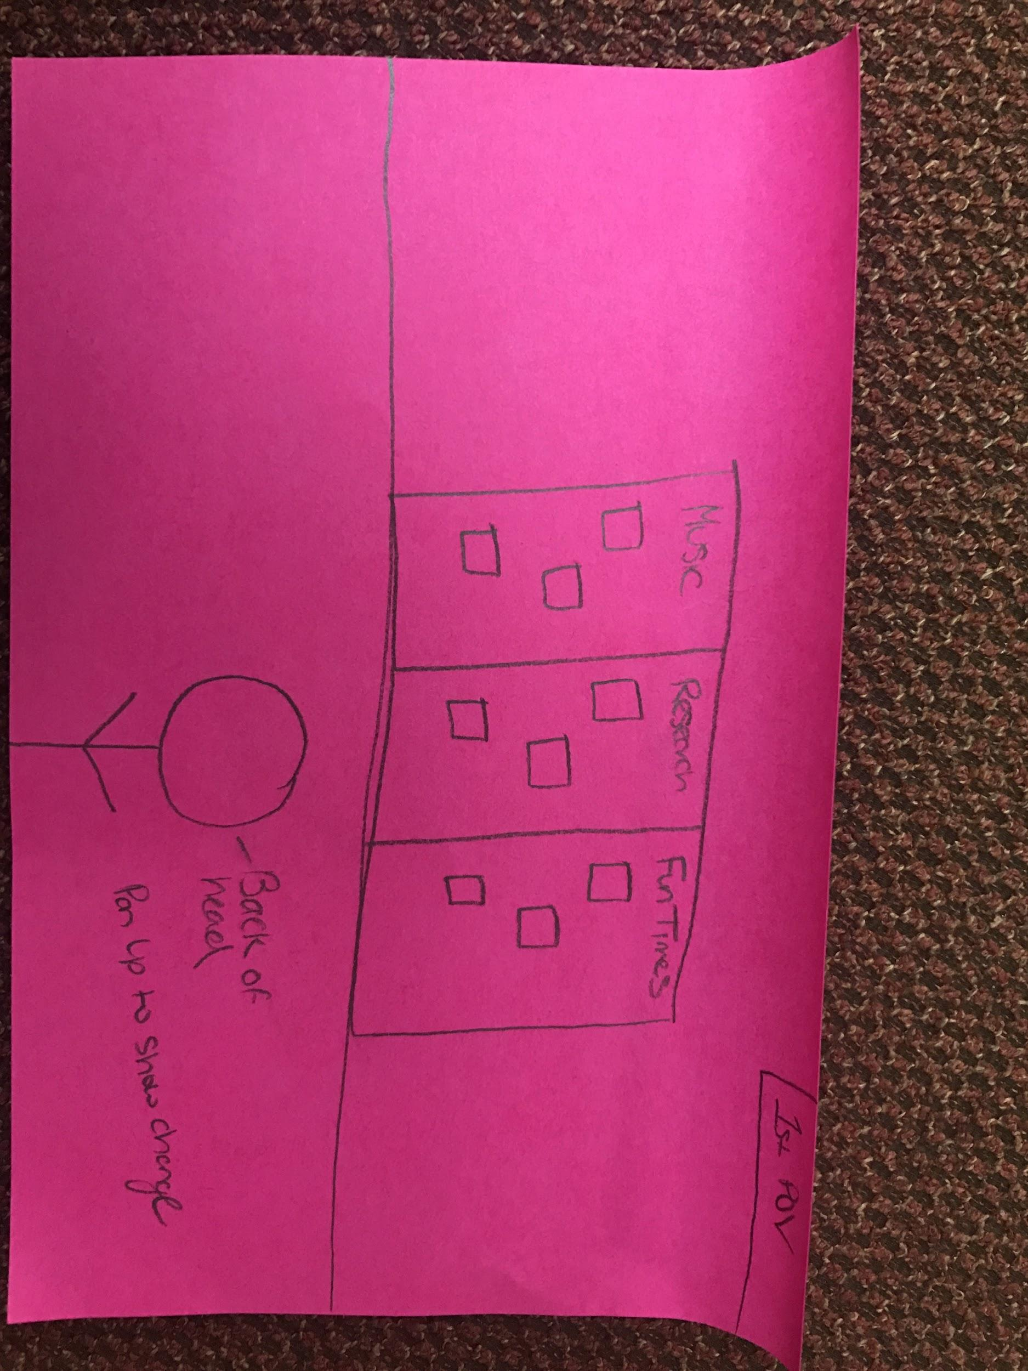
Complex Task

Slide 12


